Slide 1
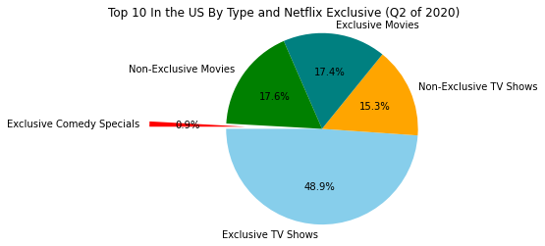
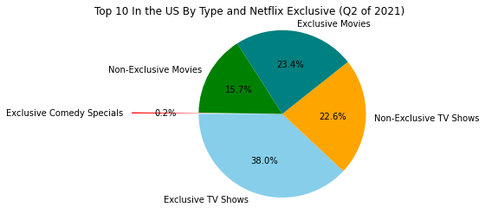
What was the popular type of entertainment on Netflix during the pandemic?
Popularity by Type During the Pandemic-Q2/2020 vs. Q2/2021
Compare the results between the two quarters
Netflix Exclusive TV shows and Non-Exclusive Movies-both dropped in popularity.
We could see that Netflix Exclusive movies increased over the same time period along with Non-Exclusive TV shows.

Slide 2
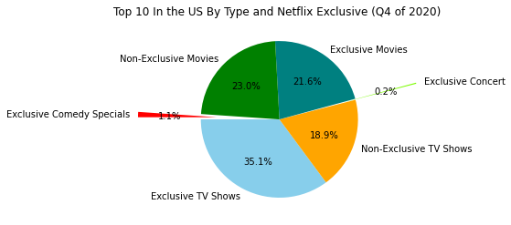
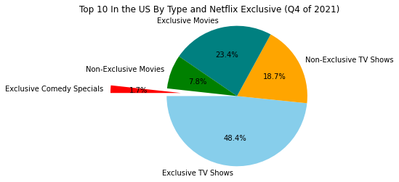
What was the popular type of entertainment on Netflix during the pandemic?
Popularity by Type During the Pandemic-Q4/2020 vs. Q4/2021
Compare the results between the two quarters.
Netflix Exclusive TV shows increased a lot bringing it back to the around the same level as the 2nd quarter of 2020.
We could see that Netflix Exclusive movies actually increased slightly over the same time period but the non-exclusive movies and TV shows remained around the same or decreased.
Throughout the timeframe, we could see a small number of comedy specials in the daily Top 10 that resulted no more than 1-2% per quarter.

Slide 3
Based on the results from the pandemic, we can see that most people preferred to watch TV shows. This is likely to have been a result of the lockdowns and people had more time to watch TV shows. Also, the popularity of certain TV shows (example-Tiger King) resulted in more people watching specifically Netflix exclusive TV shows. We could see decreases amongst the Netflix exclusive TV shows over the course of the pandemic but the comparison between the 2nd quarter of 2020 and the 4th quarter of 2021, we could see that there was little change to the popularity of Netflix exclusives.
Netflix is likely capable of being able to produce TV shows at a faster rate than movies which is likely the reason why there are a lot of options for users to watch new TV shows.

